Slide 1





THEORY
Training Program 01
Advanced NLP & Large Language Models (LLMs)

Slide 2
THEORY
Training Program 01
M01: Text Preprocessing
M02: Word and Sentence Embeddings
M03: Transformer Architectures
M04: Entity-Centric NLP
M05: Applied NLP Tasks
M06: Multimodal NLP
M07: LLM Fundamentals
M08: Prompt Engineering
M09: Fine-Tuning & PEFT
M10: RAG & Real-World Projects

Slide 3
MODULE M01
TEXT PREPROCESSING
CHAPTER M10
RAG & Real-World Projects

Slide 4
THEORY
Training Program 01
10.1 Review and Introduction to Retrieval-Augmented Generation (RAG)
10.2 RAG Architectures: Retrieval-Augmented Generation Systems
10.3 Real-World Applications of LLMs and RAG
10.4 Presentation Guidelines and Final Review
10.5 Student Capstone Project Presentations
10.6 Course Wrap-up and Next Steps

Slide 5
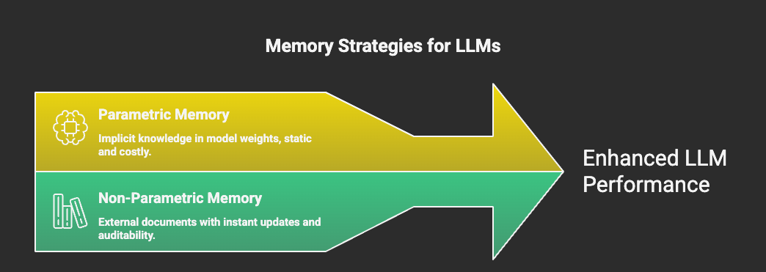
M10
Chapter 10.1 Review and Introduction to Retrieval-Augmented Generation (RAG)
Why RAG Exists
Large Language Models are powerful reasoning engines, but their knowledge is frozen in time. Retrieval-Augmented Generation (RAG) solves this limitation by connecting models to real, up-to-date, and private information sources.
LLMs suffer from a knowledge cut-off.
They cannot access private or proprietary data.
Fine-tuning is not designed to inject new facts.
RAG enables real-time knowledge access without retraining.

Slide 6
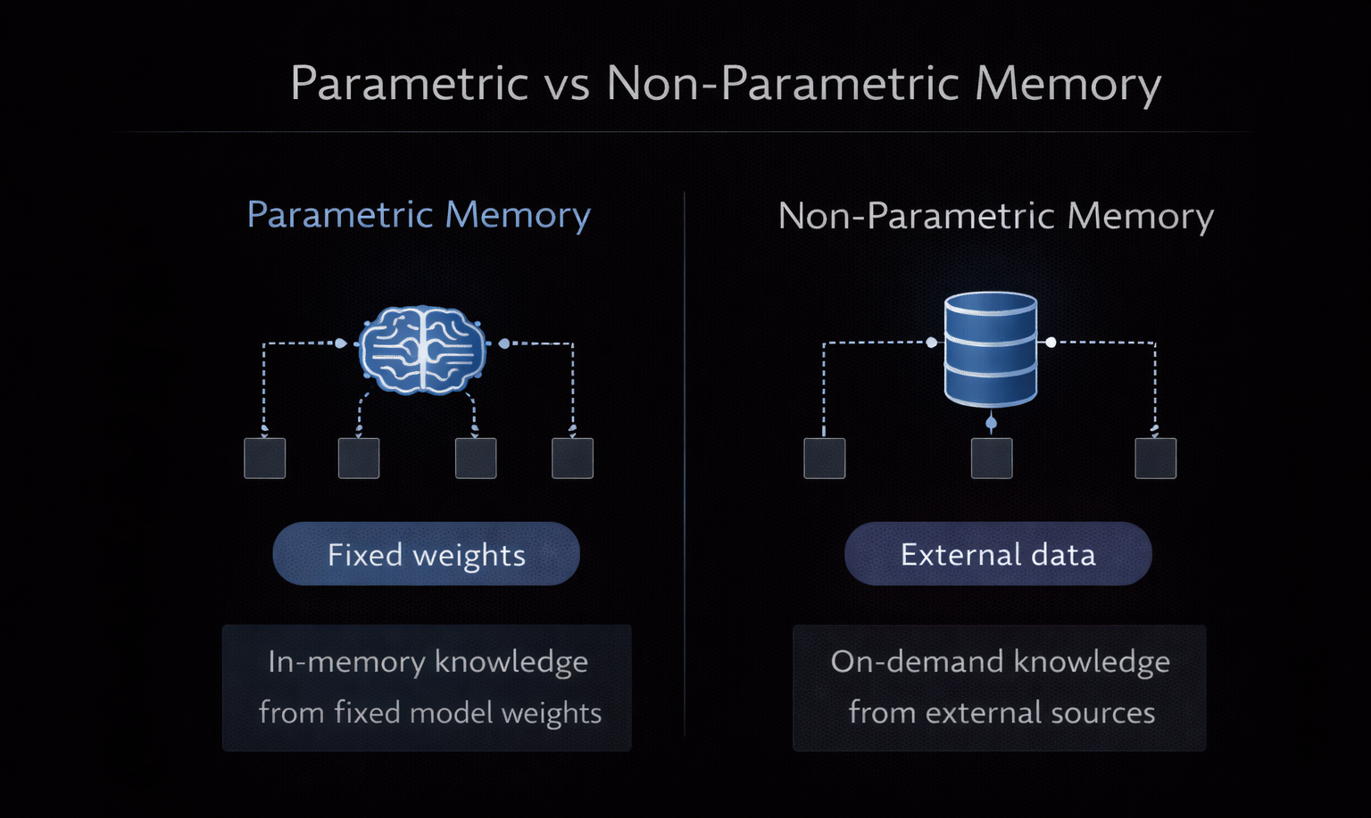
M10
Chapter 10.1 Review and Introduction to Retrieval-Augmented Generation (RAG)
Parametric vs Non-Parametric
Memory
LLMs store knowledge implicitly in weights, while RAG introduces explicit, searchable memory. This distinction is critical for reliability, updates, and compliance.
Parametric memory: knowledge encoded in model weights.
Static and expensive to update.
Non-parametric memory: external documents + retrieval.
Instantly updateable and auditable.

Slide 7
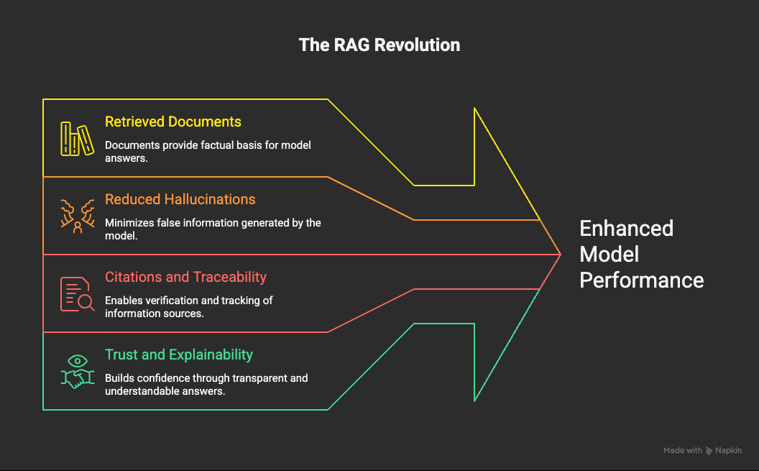
M10
Chapter 10.1 Review and Introduction to Retrieval-Augmented Generation (RAG)
What Retrieval-Augmented Generation Is
RAG transforms the model from a “knower” into a “reader”, forcing answers to be grounded in retrieved documents visible in the context window.
Model answers using retrieved documents.
Reduces hallucinations.
Enables citations and traceability.
Improves trust and explainabilit.

Slide 8
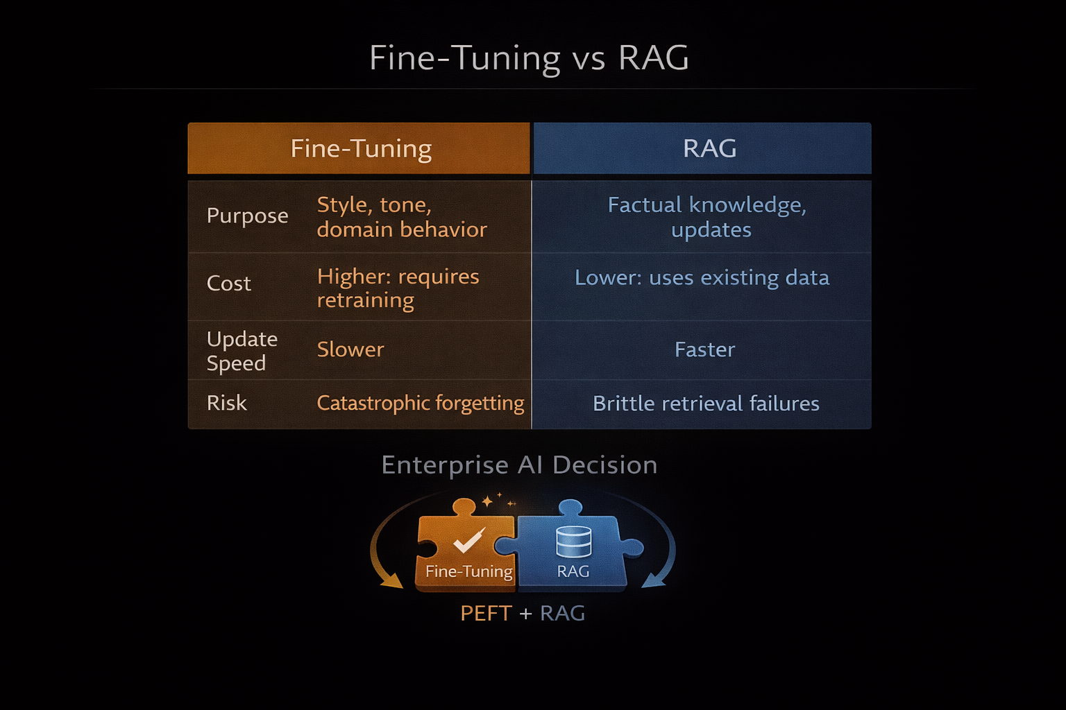
M10
Chapter 10.1 Review and Introduction to Retrieval-Augmented Generation (RAG)
RAG vs Fine-Tuning
RAG and fine-tuning solve different problems. Confusing them leads to brittle systems. The strongest architectures use both strategically.
Fine-tuning: style, tone, domain behavior.
RAG: factual knowledge and updates.
RAG avoids catastrophic forgetting.
Enterprise systems often combine PEFT + RAG.

Slide 9
THEORY
Training Program 01
10.1 Review and Introduction to Retrieval-Augmented Generation (RAG)
10.2 RAG Architectures: Retrieval-Augmented Generation Systems
10.3 Real-World Applications of LLMs and RAG
10.4 Presentation Guidelines and Final Review
10.5 Student Capstone Project Presentations
10.6 Course Wrap-up and Next Steps

Slide 10
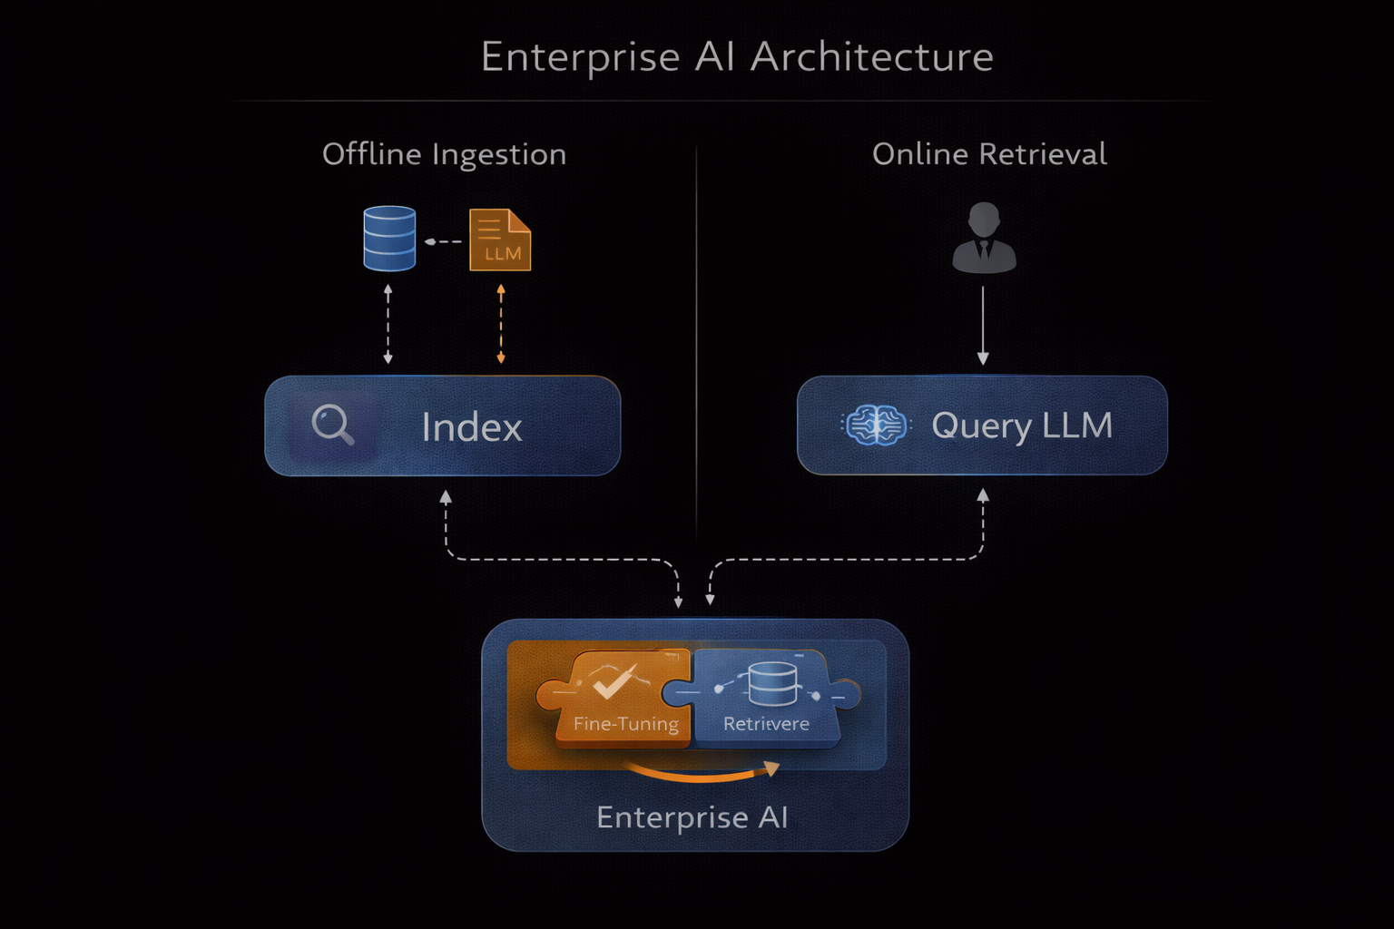
M10
Chapter 10.2 RAG Architectures: Retrieval-Augmented Generation Systems
The Hallucination Problem
LLMs are optimized for fluency, not truth. Hallucinations occur when the model fills gaps probabilistically instead of relying on verified information.
Fluent ≠ factual.
Hallucinations scale with confidence.
Dangerous in legal, medical, and financial domains.
Retrieval acts as a grounding constraint.

Slide 11
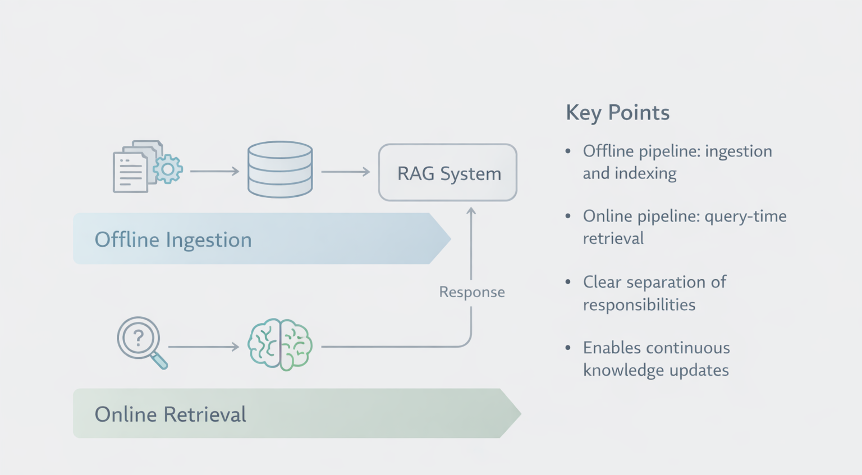
M10
Chapter 10.2 RAG Architectures: Retrieval-Augmented Generation Systems
The Dual-Pipeline RAG Architecture
A production RAG system separates knowledge preparation from real-time reasoning to ensure scalability and performance.
Offline pipeline: ingestion and indexing.
Online pipeline: query-time retrieval.
Clear separation of responsibilities.
Enables continuous knowledge updates.

Slide 12
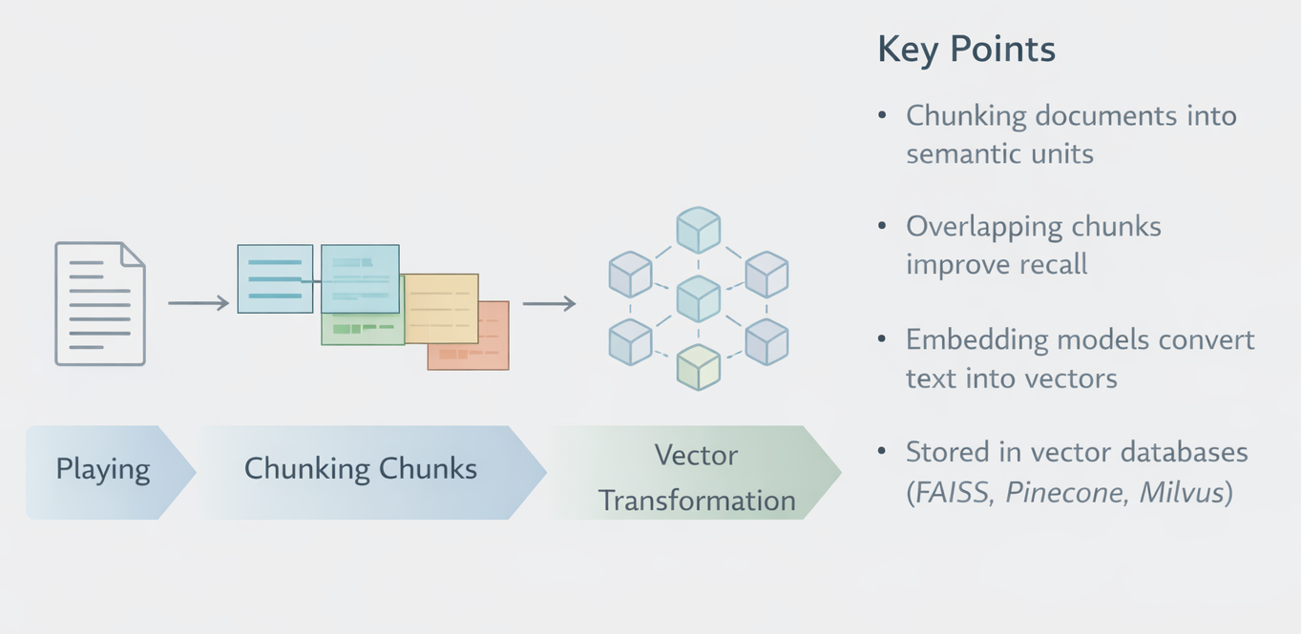
M10
Chapter 10.2 RAG Architectures: Retrieval-Augmented Generation Systems
Indexing Pipeline: Chunking
& Embeddings
Before retrieval is possible, documents must be transformed into searchable vector representations.
Chunking documents into semantic units.
Overlapping chunks improve recall.
Embedding models convert text into vectors.
Stored in vector databases (FAISS, Pinecone, Milvus).

Slide 13
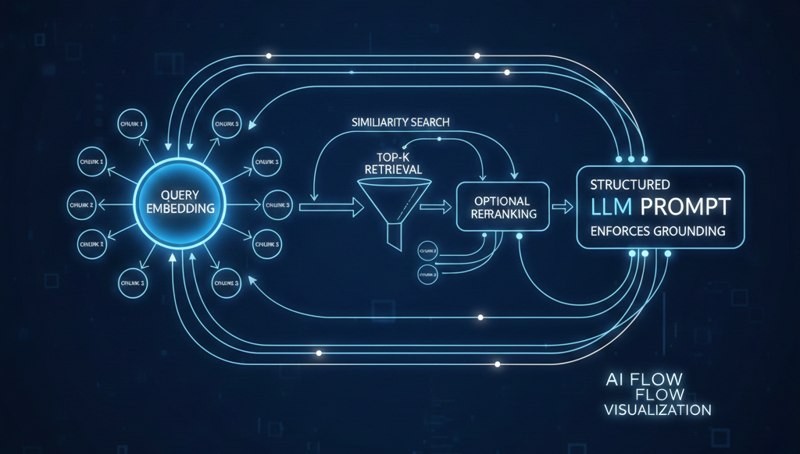
M10
Chapter 10.2 RAG Architectures: Retrieval-Augmented Generation Systems
Retrieval and Prompt Augmentation
At query time, the system retrieves the most relevant chunks and injects them into the prompt to guide generation.
Chunking documents into semantic units.
Overlapping chunks improve recall.
Embedding models convert text into vectors.
Stored in vector databases (FAISS, Pinecone, Milvus).

Slide 14
THEORY
Training Program 01
10.1 Review and Introduction to Retrieval-Augmented Generation (RAG)
10.2 RAG Architectures: Retrieval-Augmented Generation Systems
10.3 Real-World Applications of LLMs and RAG
10.4 Presentation Guidelines and Final Review
10.5 Student Capstone Project Presentations
10.6 Course Wrap-up and Next Steps

Slide 15
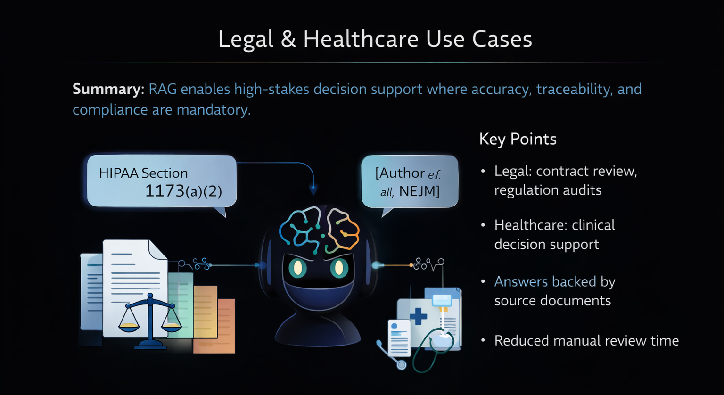
M10
Chapter 10.3 Real-World Applications of LLMs and RAG
Legal & Healthcare Use Cases
RAG enables high-stakes decision support where accuracy, traceability, and compliance are mandatory.
Legal: contract review, regulation audits.
Healthcare: clinical decision support.
Answers backed by source documents.
Reduced manual review time.

Slide 16

M10
Chapter 10.3 Real-World Applications of LLMs and RAG
Multilingual Enterprise Knowledge
Modern embeddings allow organizations to access global knowledge regardless of language barriers.
Language-agnostic embeddings.
Query in one language, retrieve in another.
Centralized global knowledge.
Automatic translation at generation time.

Slide 17
THEORY
Training Program 01
10.1 Review and Introduction to Retrieval-Augmented Generation (RAG)
10.2 RAG Architectures: Retrieval-Augmented Generation Systems
10.3 Real-World Applications of LLMs and RAG
10.4 Presentation Guidelines and Final Review
10.5 Student Capstone Project Presentations
10.6 Course Wrap-up and Next Steps

Slide 18
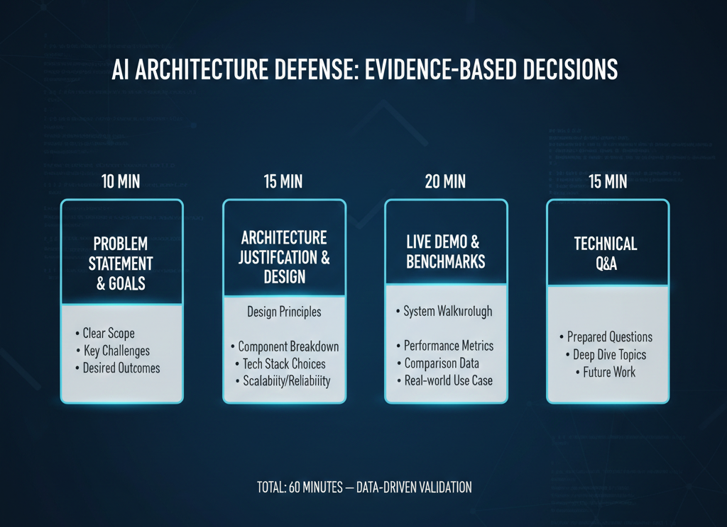
M10
Chapter 10.4 Presentation Guidelines and Final Review
How to Present a RAG System
A professional AI presentation defends architectural decisions with evidence, not narratives.
Clear problem statement.
Architecture justification.
Live demo or benchmarks.
Prepared technical Q&A.

Slide 19
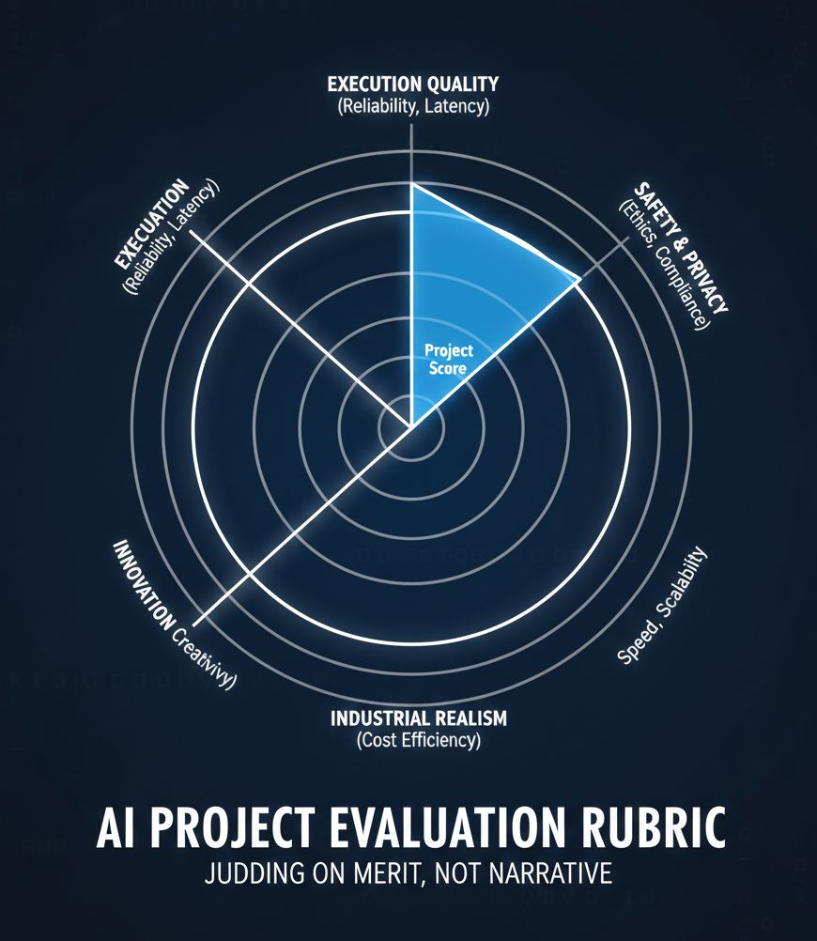
M10
Chapter 10.4 Presentation Guidelines and Final Review
Evaluation Criteria
Projects are judged on execution quality, innovation, and industrial realism.
Retrieval quality.
Latency and scalability.
Safety and privacy.
Cost efficiency.

Slide 20
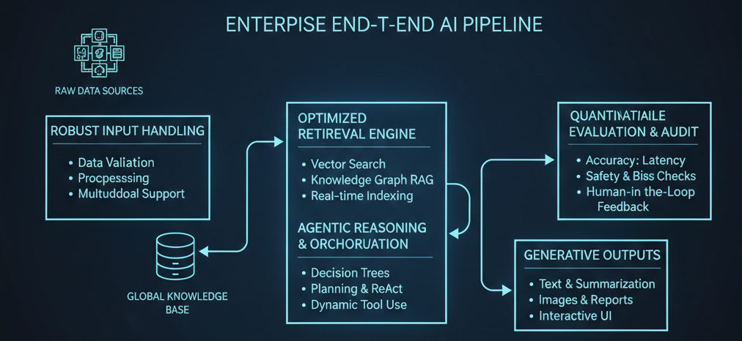
M10
Chapter 10.4 Presentation Guidelines and Final Review
Evaluation Criteria
Projects are judged on execution quality, innovation, and industrial realism.
Retrieval quality.
Latency and scalability.
Safety and privacy.
Cost efficiency.

Slide 21
THEORY
Training Program 01
10.1 Review and Introduction to Retrieval-Augmented Generation (RAG)
10.2 RAG Architectures: Retrieval-Augmented Generation Systems
10.3 Real-World Applications of LLMs and RAG
10.4 Presentation Guidelines and Final Review
10.5 Student Capstone Project Presentations
10.6 Course Wrap-up and Next Steps

Slide 22
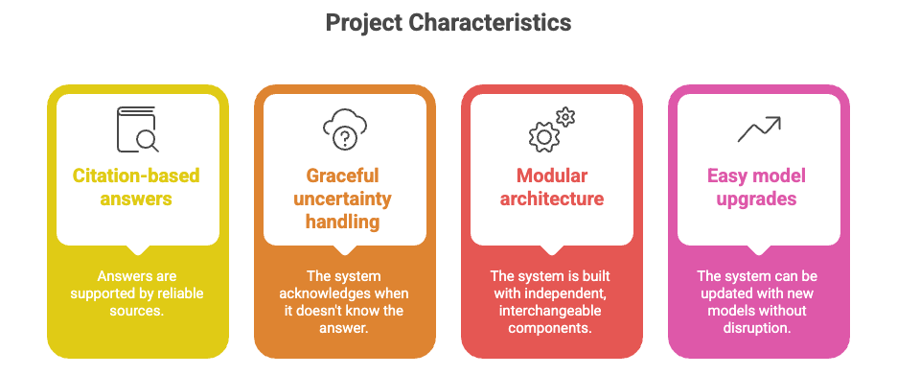
M10
Chapter 10.5 Student Capstone Project Presentations
What Excellence
Looks Like
Capstone projects demonstrate full-stack AI system thinking, not isolated techniques.
Robust input handling.
Optimized retrieval.
Agentic reasoning.
Quantitative evaluation.

Slide 23
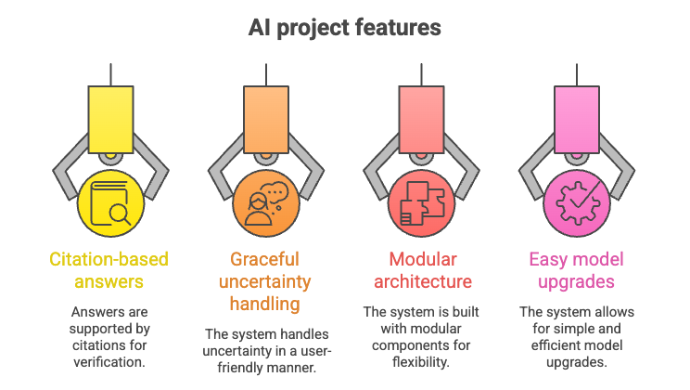
M10
Chapter 10.5 Student Capstone Project Presentations
Production-Ready
Criteria
Top projects balance factuality, usability, and maintainability.
Citation-based answers.
Graceful uncertainty handling.
Modular architecture.
Easy model upgrades.

Slide 24
THEORY
Training Program 01
10.1 Review and Introduction to Retrieval-Augmented Generation (RAG)
10.2 RAG Architectures: Retrieval-Augmented Generation Systems
10.3 Real-World Applications of LLMs and RAG
10.4 Presentation Guidelines and Final Review
10.5 Student Capstone Project Presentations
10.6 Course Wrap-up and Next Steps

Slide 25
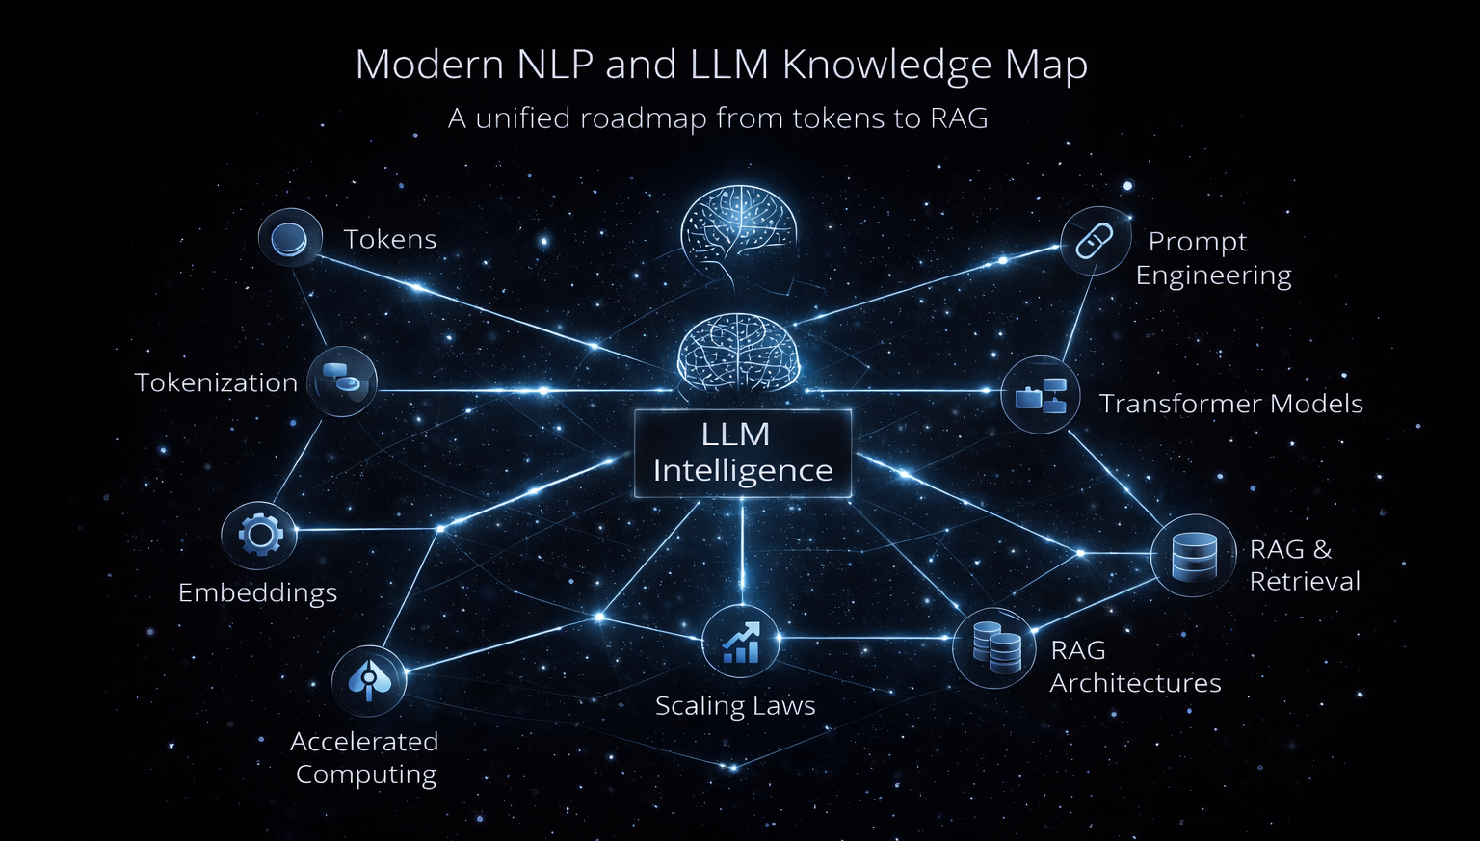
M10
Chapter 10.6 Course Wrap-up and Next Steps
What You Have Mastered
This course covered the complete modern NLP and LLM stack, from tokens to enterprise-grade systems.
Tokenization & embeddings
Transformers & scaling laws
Prompt engineering
PEFT & LoRA
RAG architectures

Slide 26
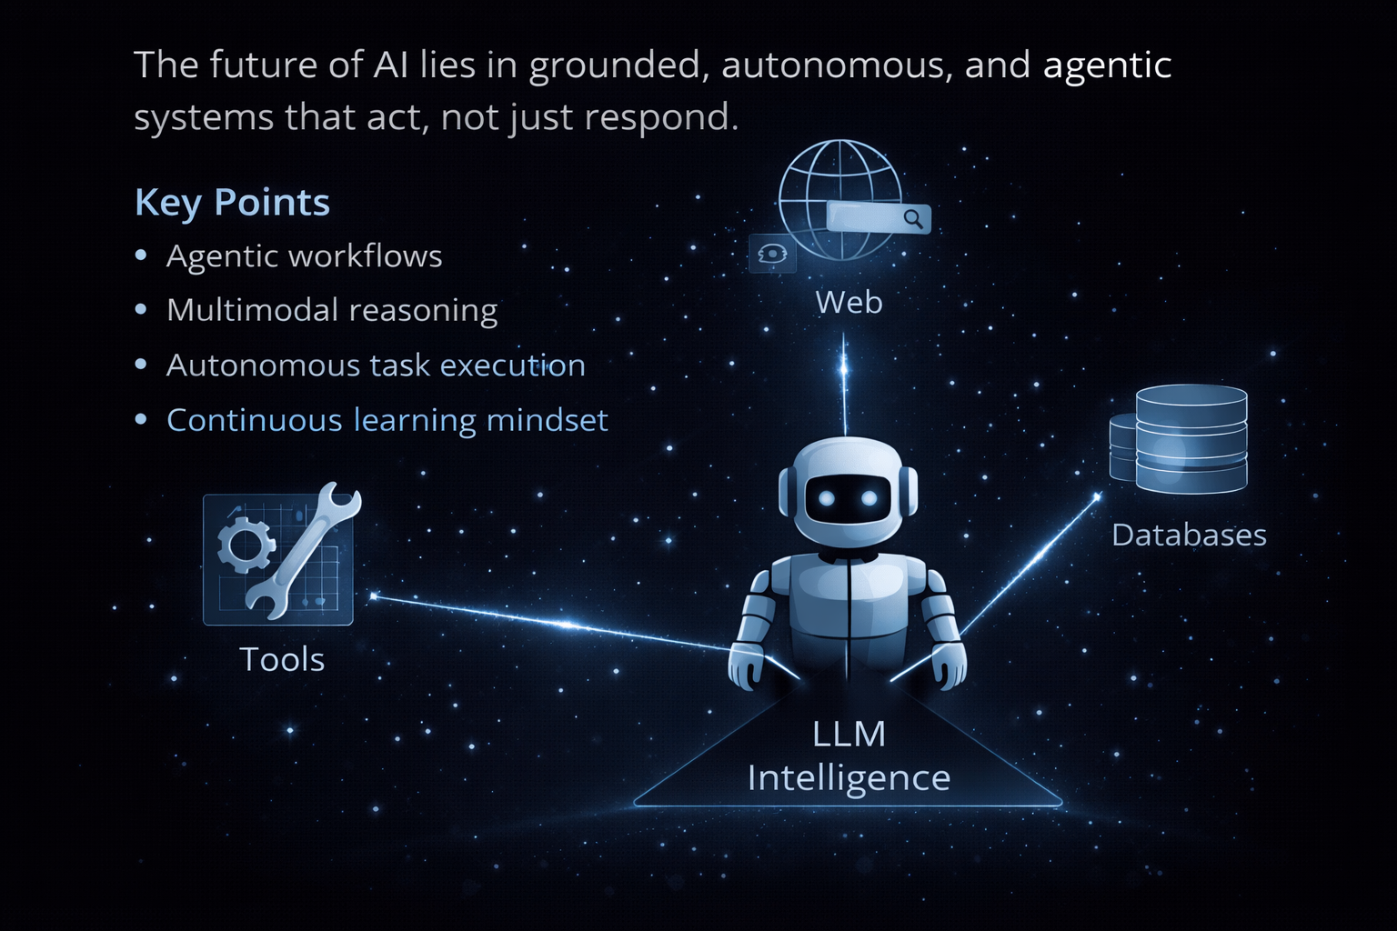
M10
Chapter 10.6 Course Wrap-up and Next Steps
The Road Ahead
The future of AI lies in grounded, autonomous, and agentic systems that act, not just respond.
Agentic workflows
Multimodal reasoning
Autonomous task execution
Continuous learning mindset

Slide 27
M10
References & Further Reading
Lewis et al. (2020) — Retrieval-Augmented Generation for Knowledge-Intensive NLP Tasks.
Guu et al. (2020) — REALM: Retrieval-Augmented Language Model Pre-training.
Borgeaud et al. (2022) — Improving Language Models by Retrieving from Trillions of Tokens (RETRO).
Mialon et al. (2023) — Augmented Language Models: A Survey.
Es et al. (2023) — RAGAS: Automated Evaluation of Retrieval-Augmented Generation.
Barnett et al. (2024) — Seven Failure Points When Engineering a RAG System.
Zobel & Moffat (2006) — Exploring the Boundaries of Low-Cost Retrieval Evaluation.
Bender et al. (2021) — On the Dangers of Stochastic Parrots.

